Slide 1
ENGR 290
Atomic Arrangements

Slide 2
Periodic Table
Dimitry Mendeleyev was the first to arrange the Periodic Table of Elements based on their atomic mass in 1869.
Of the 103 accepted elements (117 or 118 in total are known)
80 are metal
9 are non-solids.
8 are reactive gases
6 are Noble (inert) gases
The metals break down into three broad groups
The True Metals – with filled inner electron shells
The Transition Metals – with unfilled d-electron states
The Rare Earths and Actinides – with unfilled f-electron states.

Slide 3
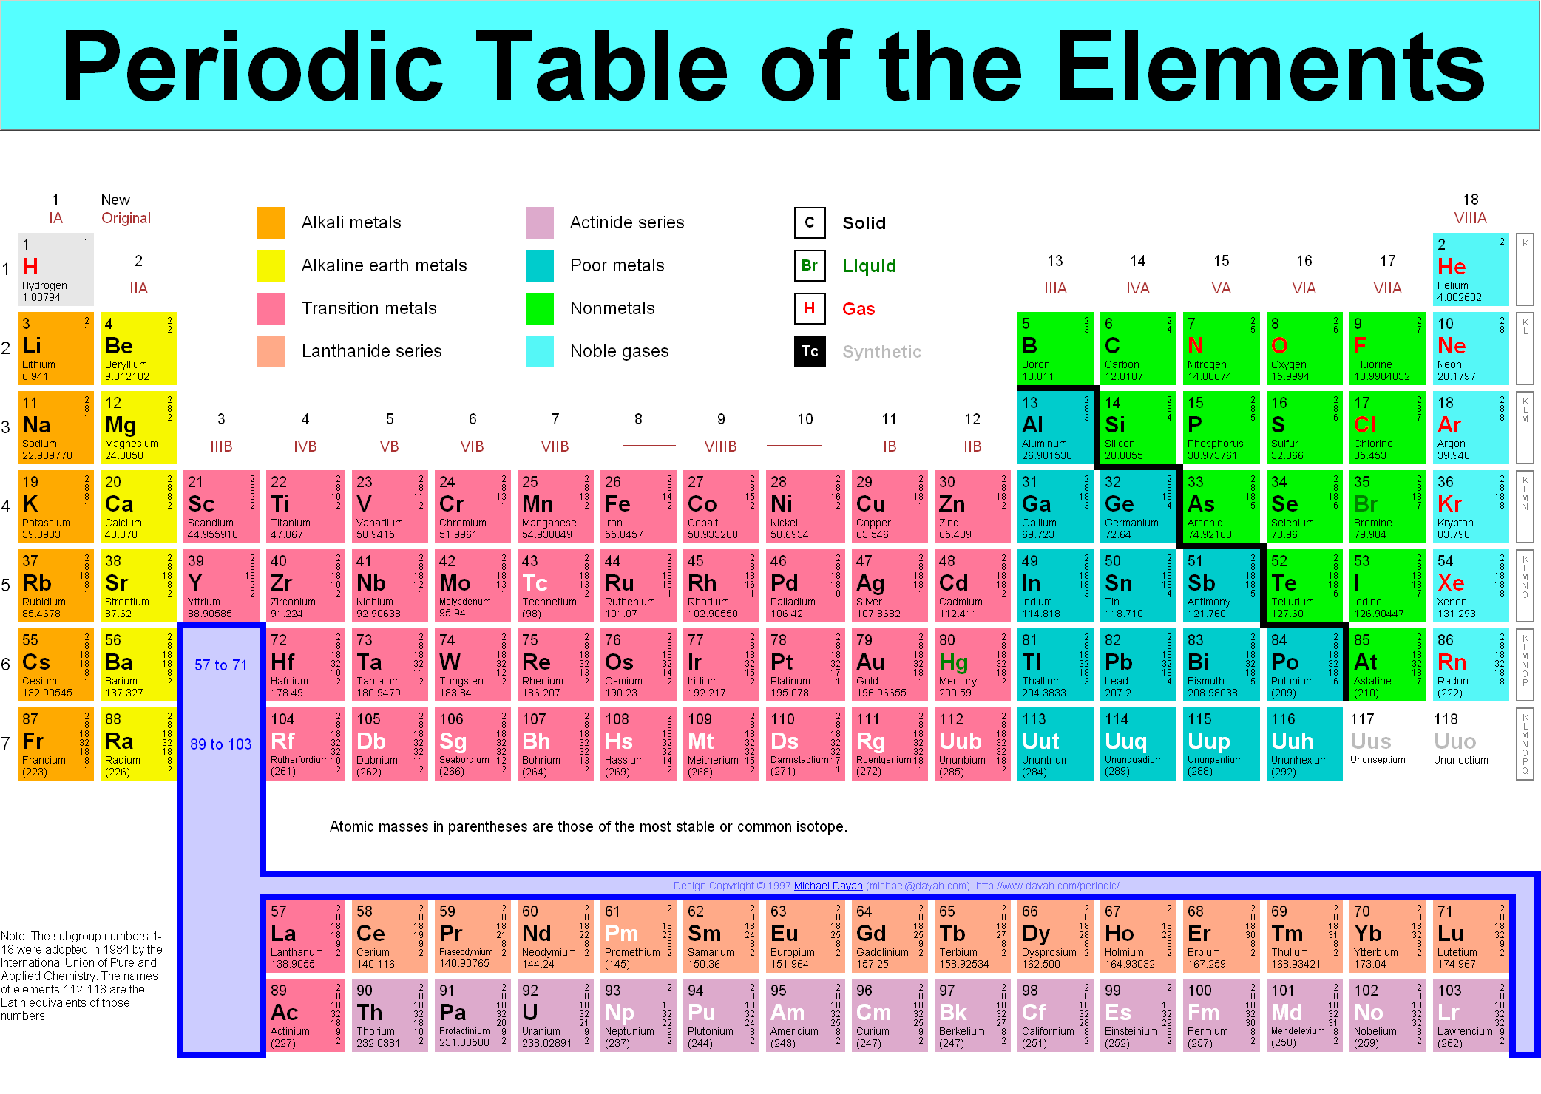

Slide 4
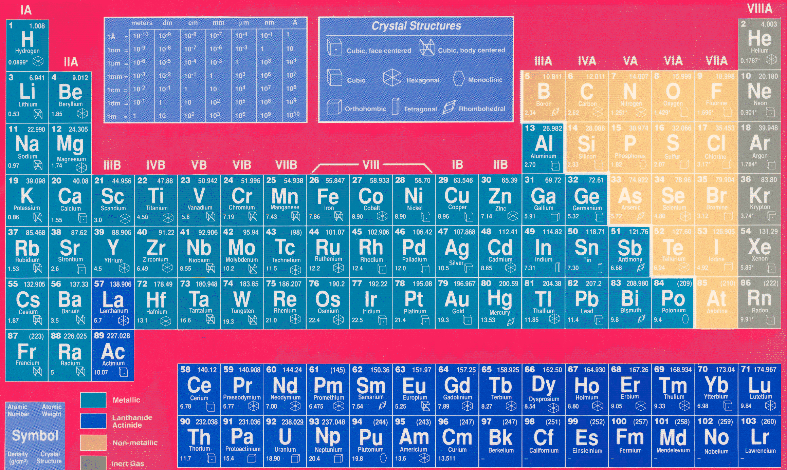
The atomic number, atomic mass, density and crystal structure are given.

Slide 5
Definitions
The Bohr Model for atoms
Oxygen:
8 electrons (2,6)
8 protons
8 neutrons
8 +
8 N

Slide 6
Definitions
The Quantum Model for atoms
Oxygen:
8 electrons ( 1s², 2s², 2p⁴)
8 protons
8 neutrons
8 +
8 N

Slide 7
Definitions
Quantum model:
Electronic energy levels in atoms are specified by using quantum numbers.
The principal quantum is “n”.
n indicates the primary electron shell in an atom where the shells are represented by K=1, L=2, M=3, etc.
Orbits (1 to 7)
Sub levels [Orbital (azimuthal) quantum number] are designated by the letters S, P, D, and f. They are denoted by s = 0, p = 1, d = 2, f = 3, etc.

Slide 8
Definitions
Quantum model (cont’d):
The exponent designates the number of electrons at each level.
The rows of the periodic table are the periods. Each row ending with an inert gas (farthest right).
Since each column has the same number of valance (outer shell) electrons, the elements in the column have similar chemical properties.

Slide 9
Definitions
The magnetic quantum number is “m_{l} ”
m_{l} indicates the effects that a magnetic field may have on the electronic energy level in an atom.
m_{l} = -l, … 0 … +l for a total of 2l + 1 values.
The spin quantum number is m_{s} = +1/2 or –1/2.
m_{s} indicates the direction of the intrinsic (internal) electron angular momentum (magnetic moment).
Usually referred to as spin up (+) and spin down (-).
This property is now being used in Spintronic Materials (eg., Gallium Arsenide, GaAs) to produce ultra-fast electronic devices based on Spintronics.

Slide 10
Definitions
Pauli Exclusion Principle:
This principle states that no two electrons can have the same set of quantum numbers and no more than two electrons have the same energy level in the absence of a magnetic field.
The electronic configuration of the different energy levels fill in a relatively straight forward pattern in a shorthand notation using the l quantum numbers.
1s² 2s² 2p⁶ 3s² 3p⁶ 3d¹⁰ 4s² 4p⁶ 4d¹⁰ 5s² … .
eg., for Carbon, which has an atomic number of 6, it has 6 protons and 6 electrons. It’s electronic configuration in shorthand notation is:
1s² 2s² 2p²

Slide 11
Terminology
Non-crystalline structure (amorphous solids):
Glasses and plastics
Crystalline structure:
Metals and inorganic compounds
Crystalline structures have repeated structures called “unit cells”. These unit cells form a 3-dimensional array called a “lattice”. These lattices will stack and align to form a crystal. The crystals will combine to form grains, which will meet to form “grain boundaries”.

Slide 12
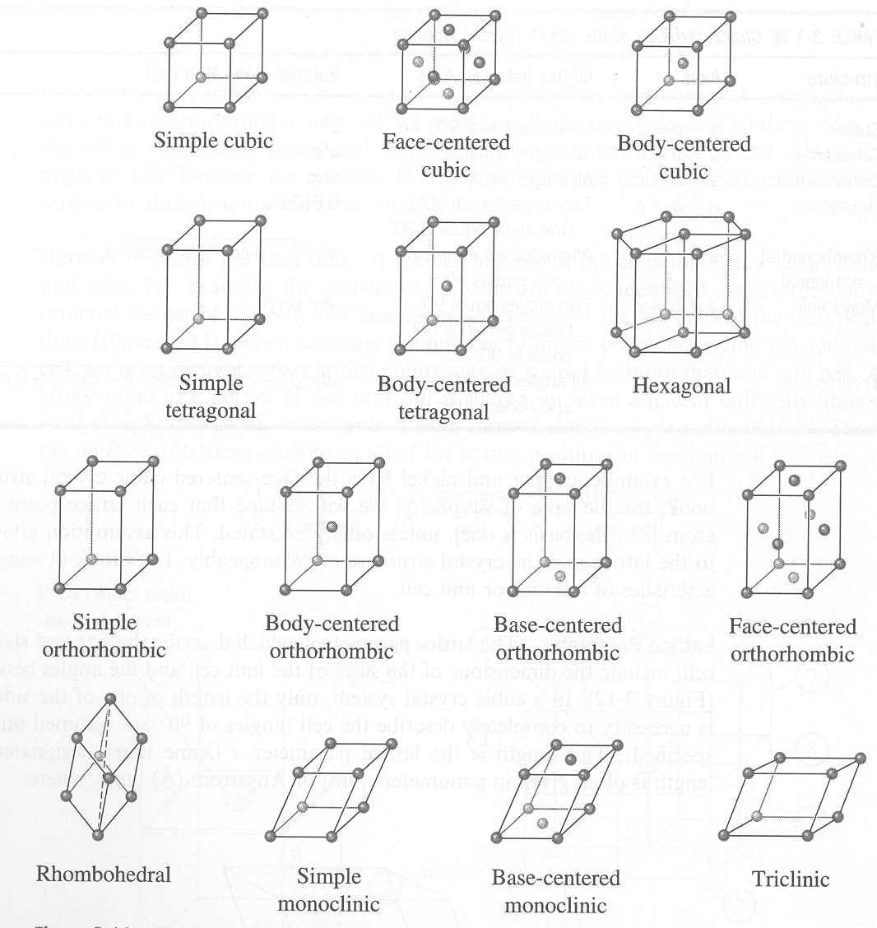
Terminology
Example: Unit cells
abc,abc
ab,ab,ab

Slide 13
Terminology
Although amorphous solid materials do not have an ordered structure, they often have “short-range ordering”.
e.g.
glass (short-range order) – clunk sound
crystal (long-range order) – ring sound
Metals:
When metals are subjected to atomic loading, rather than break (cleave) the metal atoms, the loading will cause “atomic slip”.

Slide 14
Terminology
Metals (cont’d):
When planes of atoms “slip”, they can produce edge dislocations.
Slip step
Edge dislocation

Slide 15
Terminology
Dislocations:
Dislocations are caused by crystal mismatch during solidification, external stresses (plastic deformation) or by adding alloying elements.
By adding larger impurity atoms to a metal, we can prevent (reduce) dislocations. This method is referred to as “solid solution strengthening”.
Dislocations can interfere with each other, which also causes strengthening in metals. To obtain multiple dislocations (that interfere with each other) metals can be mechanically worked work hardening).

Slide 16
Terminology
Dislocations cont’d):
Non-ferrous (no iron in them) metals can be strengthened by adding alloying elements which agglomerate within the metal lattice when subjected to heat-treating techniques. This is called “precipitation hardening”.
Of lesser importance, is “dispersion hardening”, which is similar to precipitation hardening but uses fine, non-deformable particles.
The most important strengthening method in metals is “quench hardening”. Here trapped atoms actually change the atomic spacing.

Slide 17
Terminology
Phases:
Phases are changes in crystal structure and can be found on phase diagrams (equilibrium phase diagrams).
i.e. austenite is a phase in steel.
Transformations:
Typically retain the crystal structure, but with a re-orientation.
i.e. martensite is a transformation in steel.
Dipole:
Induced dipoles occur when an atom is placed an external electric field. The electrons are displaced from their normal positions relative to the nucleus. At their new positions , these electrons iduce a dipole within the atom, which is actually a redistribution of charge.

Slide 18
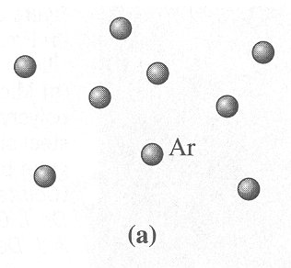
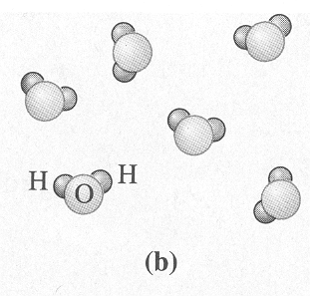
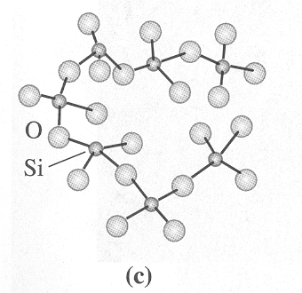
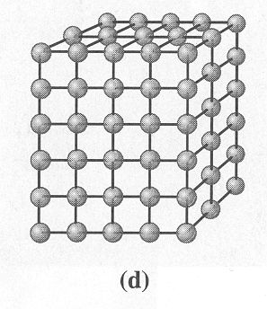
Levels of atomic arrangement where a) has no ordering of atoms, b) and c) have short range order and d) has short and long range order.

Slide 19
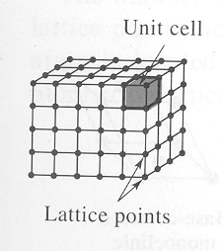
Crystal Structure
A “unit cell” is a subdivision of the lattice that has all the geometric characteristics of the total crystal.
The simplest choice of this repeating combination of the atoms on a set of lattice points is called the unit cell.
All unit cells in a perfect crystalline solid are identical so if we describe one unit cell then we have described them all.

Slide 20
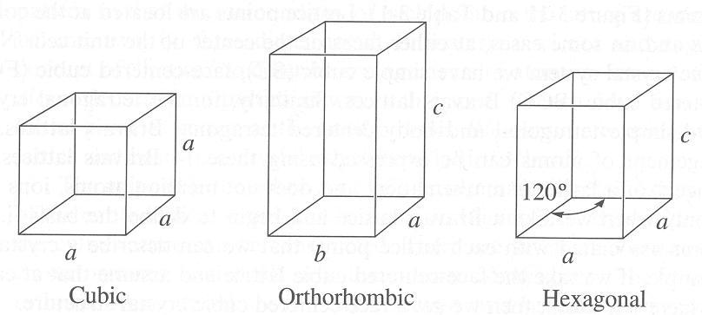
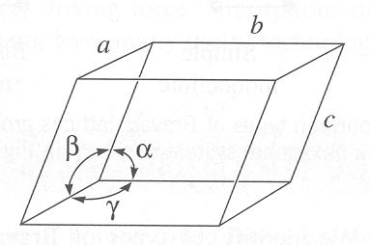
Crystal Structure
The lattice parameters describe the size and shape of the unit cell.
There are three lengths, a, b, and c that describe the cell’s edges.
There are three angles, alpha, beta, and gamma, that describe the three angles between the adjacent cell axes.
Lattice parameters and their use to describe crystal systems.

Slide 21
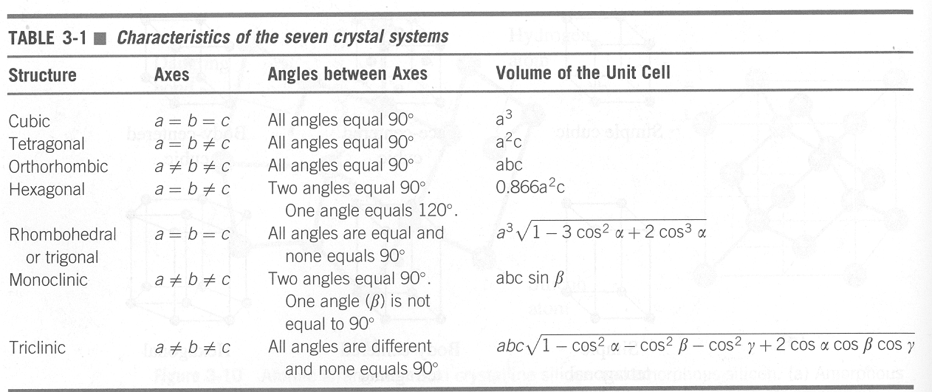
Crystal Structure
There are only seven unique Crystal Systems, i.e.,
  1. Cubic 2. Tetragonal 3.Orthorhombic 4. Rhombohedral
  5. Hexagonal 6. Monoclinic 7. Triclinic

Slide 22
Crystal Structure
There are 14 types of unit cells or Bravais lattices that are grouped into the 7 crystal systems (see next slide).
There are four basic types of unit cells:
  Simple
  Body-centered
  Face-centered
  Base-centered
These lattices are the skeletons of solids upon which the crystal structures of atoms are built

Slide 23
The fourteen types of Bravais lattices grouped into the seven crystal systems.

Slide 24
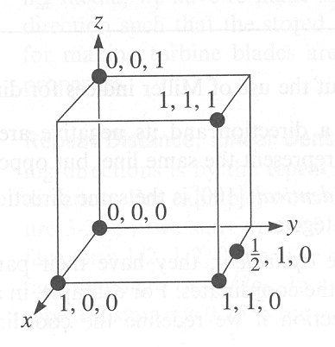
Crystal Structure
Direction vs. Postion:
Position is denoted by the unit cell having a value of 1 for each side (i.e. for a cubic unit cell). Thus, an atom in the middle of a BCC unit cell is located at a position of ½, ½, ½ .

Slide 25
Crystal Structure
Direction vs. Postion (cont’d):
Directions are designated by square brackets [uvw]. The BCC center atom is in the direction [111] from the corner (origin). When a direction is pointing in a negative direction (on any axis), we use a bar to indicate the negative.
i.e. (Direction)
Since all [111] diagonals from the origin are identical (in that they all travel corner to corner through a cubic unit cell) and only our chosen orientation is different, we can gather them together as a “family of directions”

Slide 26
Crystal Structure
Angle between directions:
To assist with determining the mechanical properties, it is useful to know the angle between the direction vectors.
The angle can be calculated using trigonometry. For the cubic system (only) the angle can be found using the following equations:
or

Slide 27
Crystal Structure
Angle between directions (cont’d):
where:
D = ua+vb+wc
D’ = u’a+v’b+w’c
δ = the angle between these two directions
Remember: they only apply to the cubic system.

Slide 28
Crystal Structure
Miller indices:
Lattice planes are described using Miller indices. To indicate a plane, integers in curved brackets are used.
i.e. (210)
“Miller Indices” are also used for atomic planes in cubic crystals.
The Miller indices of an atomic plane are defined as the reciprocals of the fractional intercepts that the plane makes with the crystallographic x, y, z axes of the three non-parallel edges of the cubic unit cell.

Slide 29
Crystal Structure
Procedure for determining the nomenclature of planes:
  Choose a plane which does not pass through the origin. (!)
  Determine the intercepts of the plane in terms of the crystallographic x, y, z axes for a unit cube. These intercepts may be fractions.
  Form the reciprocals of these intercepts.
  Clear the fractions and determine the smallest set of whole numbers that are in the same ratio as the intercepts. These whole numbers are the Miller indices of the crystallographic plane and are enclosed in round parentheses without the use of commas.
  The notation (hkl) is used to indicate Miller indices of planes in a general sense, where h, k, and l are the Miller indices of a cubic crystal plane for the x, y, and z axes, respectively.
  Note the round brackets and again, negative numbers should be written with a bar over the number.

Slide 30
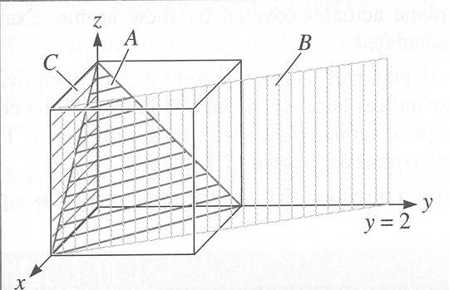
Crystal Structure
Determine the Miller indices of planes A, B, and C in the figure below.
Plane A
  1. x = 1, y = 1, z = 1
  2. 1/x = 1, 1/y = 1, 1/z = 1
  3. No fractions to clear or integers to reduce
  4. (111) is the answer.
Plane B
  1. x = 1, y = 2, z = infinity
  2. 1/x = 1, 1/y = 1/2, 1/z = 0
  3. clear fractions: 1/x = 2, 1/y = 1, 1/z = 0
  4. (210) is the answer
Plane C – we must move the origin since it passes through 0,0,0. We’ll move it one lattice parameter in the negative y-direction. Then,
  1. x = infinity, y = -1, z = infinity
  2. 1/x = 0, 1/y = -1, 1/z = 0
  3. No fractions to clear or integers to reduce
  4. is the answer

Slide 31
Crystal Structure
Miller indices (cont’d):
0,0,0
b
2-dimensional view (Top view)
½ a
2,1,0
The (210) describes a vector that is orthogonal to the plane itself. Standard notation is given as (h k l); however, hexagonal and rhombohedral cells can be defined using a 4-digit system. i.e. (h k i l)

Slide 32
Crystal Structure
Miller indices (cont’d):
This extra digit makes similar planes easier to note.
A family of planes of denoted by:

Slide 33
Crystal Structure
Interplanar spacing:
Given two adjacent parallel planes of atoms (i.e. the planes have the same miller indices) the distance between the planes is denoted by d_{hkl}.
For cubic crystals d_{hkl} is found using the following equation:
where:
a₀ = the lattice parameter
h, k, l = the miller indices of the planes being considered

